Slide 1
Forcing IE 10 & 11 to play nicely with Retail Link™
Dan Batson
Sr. Analyst / Category Advisor
Fujifilm North America Corporation

Slide 2
Yes, Internet Explorer 10 & 11 can work with Retail Link™
Disclaimer: The official Retail Link Help Desk statement currently states they are not able to help users using anything other than IE 8 (recommended version), they will assist with up to IE 9.
With the above statement, why would a supplier want to use IE 10 or 11?
Some sites will not work properly with older versions of IE (ex: version 8) since they don’t fully support current, up-to-date technologies, such as HTML 5, etc.
User or company wants a browser with higher level security
Windows 7 updated your current browser version
Microsoft software version sundown

Slide 3
Yes, Internet Explorer 10 & 11 can work with Retail Link™
If you have already tried to use IE 10 or 11 with Retail Link and found things either didn’t appear correctly or work properly, the real reason isn’t that it doesn’t support 10 or 11, as both are backward compatible, it is because of settings issues.
Let’s take a look at what settings need to be changed in order to force your IE 10 or 11 to work properly and play nice with Retail Link.
The following screen shots come from IE 11 on my Windows 7, 64-bit system. Almost all portals have proven to work after making these changes (with some slight issues in certain portals, but nothing you won’t be able to work around. Please note IE 10 menus are slightly different, but settings screens are the same.

Slide 4
Tools
The tools are located within the gear icon at the top right-hand corner of IE 11.

Slide 5
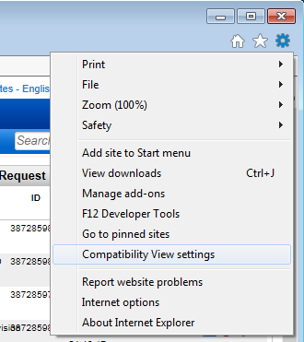
Compatibility Settings
Find the menu item for Compatibility View Settings and select that.
Adding a website to Compatibility View Settings tells IE you want it to be backwards compatible for that website.

Slide 6
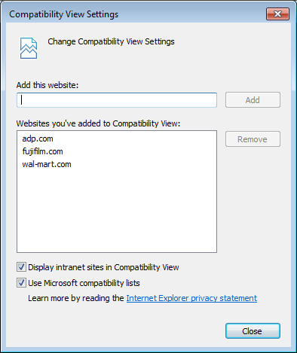
Compatibility Settings
In the top dialogue box labeled, Add this website, type in the root of the website you wish to add.
We say ‘root’ because we want anything within that website domain to be a part of our compatibility settings. Since we want the root, forget about the http:// or https:// or even the www.
Example: If we wish to add https://retaillink.wal-mart.com
We would simply type wal-mart.com
Be sure the two bottom boxes are checked (turned on) and then select the CLOSE button.

Slide 7
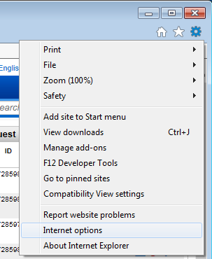
Internet Options
The rest of our tasks will be performed in this master Internet Options menu.
Click on the Settings gear again and select Internet Options.

Slide 8
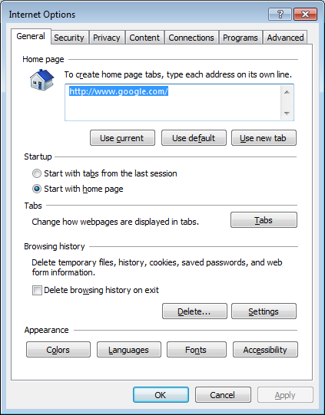
Internet Options
Now that we have told IE we want it to use compatibility view settings on our wal-mart.com website, we need to clear our cache and history so it deletes temporary files from the last time we visited the site (we want to force IE to start fresh).
Under the General tab, look for the section titled Browsing history and click the Delete… button.

Slide 9
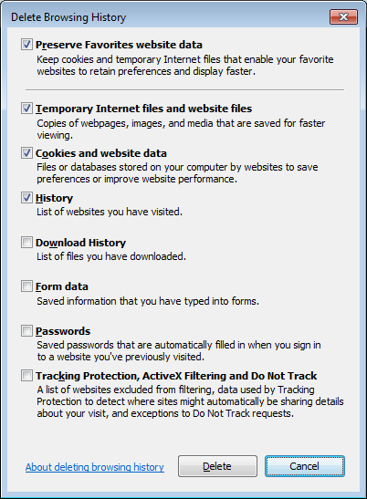
Browsing History
Make sure you have the top four selections selected (checked) so you retain the ones not checked...
You’ll be retaining:
Download History
Form data
Passwords
Tracking Protection…
Click the Delete button and wait for it to complete.
For future reference, if you ever have problems with websites, you can come back in here and uncheck the setting to Preserve Favorites website data and select delete. This will clear out your favorite website temp files and cookies so you can start fresh. Only use this if you suspect something has become corrupt. In my opinion, it is better to just click the REFRESH button while at the website.

Slide 10
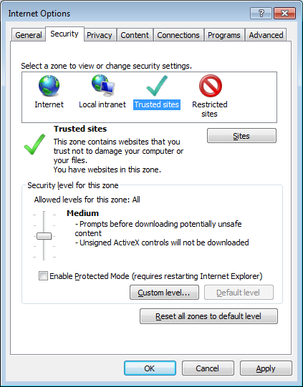
Trusted Sites
With your Internet Options screen still open, click the Security tab and then select Trusted Sites.
With that selection, make sure the Security level is set to Medium and then click the Sites button.

Slide 11
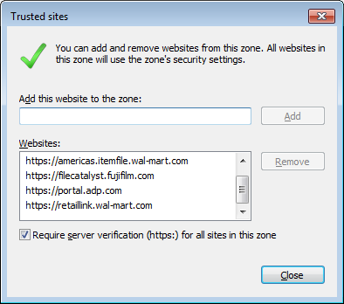
Trusted Sites
Any site you add to this Trusted sites setting will use a separate security level than those that aren’t listed here. If nothing is listed here, your browser is set to treat every site as an internet site zone. Those security settings will not allow us to utilize Retail Link they way we want.
It is always good practice to make sure the Require server verification (https:) for all sites in this zone is checked. We don’t want unsecure, un-verified sites to utilize the more liberal settings we are about to put in place.
Be sure to add the following and then click the Close button:
https://retaillink.wal-mart.com
https://americas.itemfile.wal-mart.com

Slide 12
Custom Level
If you want to double-check your security details for trusted sites, you can use the following to mimic the settings on your system. In most cases, the default medium setting is okay. But just in case, here are the screen shots of what my settings are.
Back to our Internet Options window, with Trusted sites still selected, click the Custom level… button.
Again, the following slides for custom level are provided as reference if you choose to walk through each one.

Slide 13
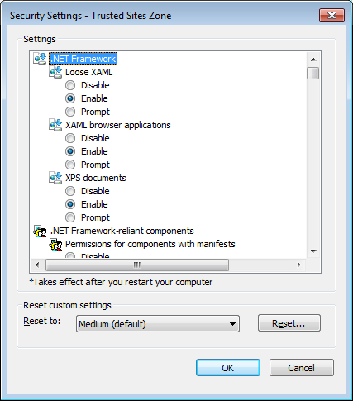
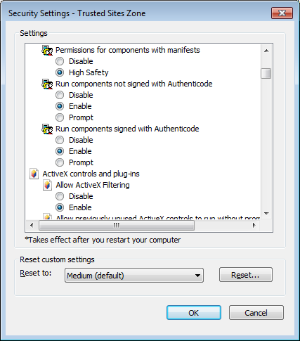
Trusted Sites – Custom Level Security

Slide 14
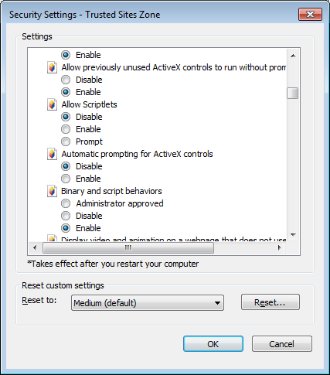
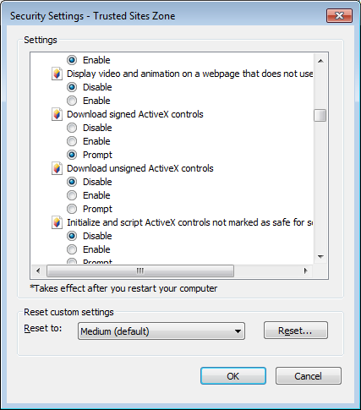
Trusted Sites – Custom Level Security

Slide 15
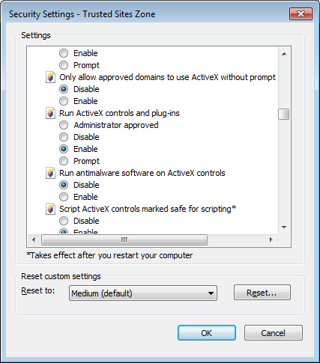
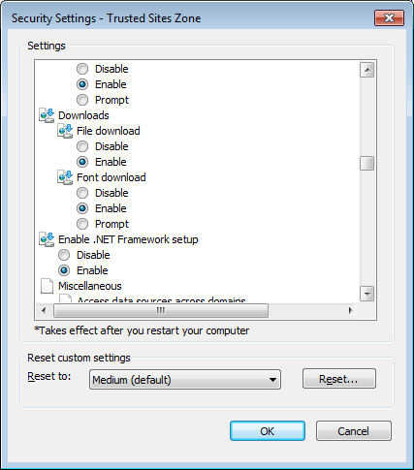
Trusted Sites – Custom Level Security

Slide 16
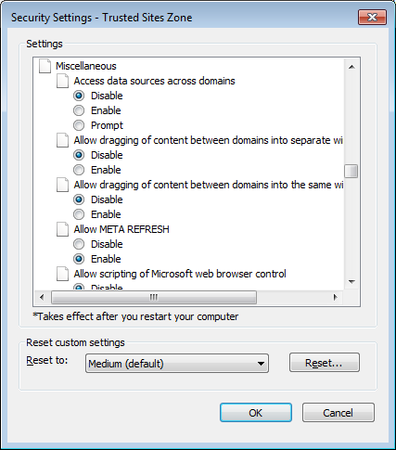
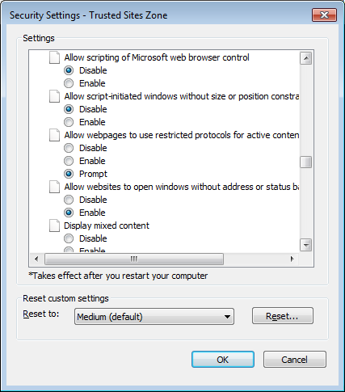
Trusted Sites – Custom Level Security

Slide 17
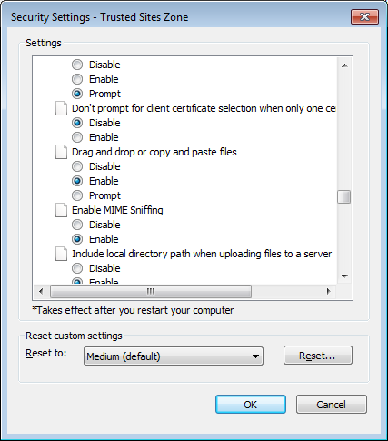
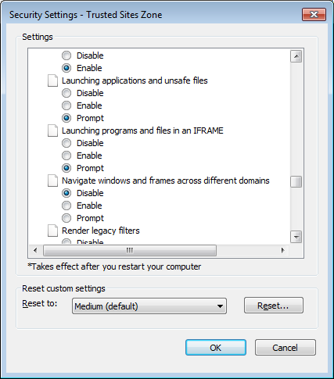
Trusted Sites – Custom Level Security

Slide 18
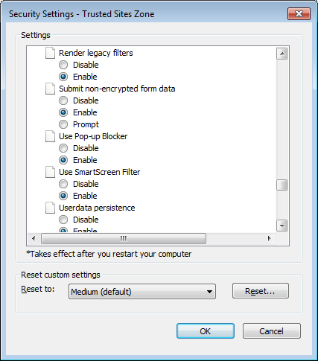
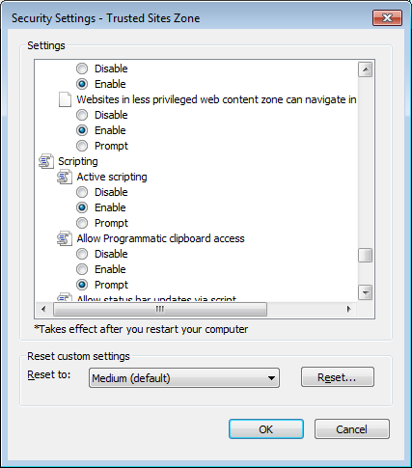
Trusted Sites – Custom Level Security

Slide 19
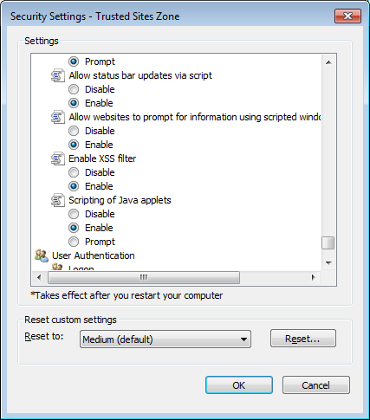
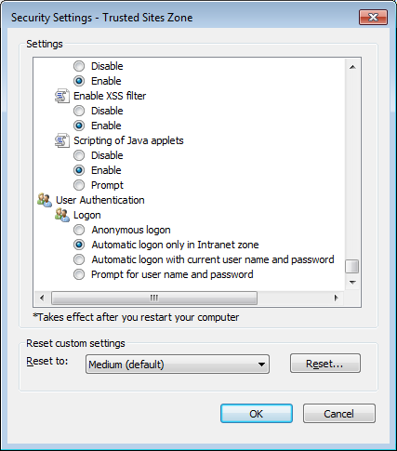
Trusted Sites – Custom Level Security

Slide 20
Custom Level
Once you have finished making your selections, click OK and then back at you Internet Options window, be sure to click Apply.

Slide 21
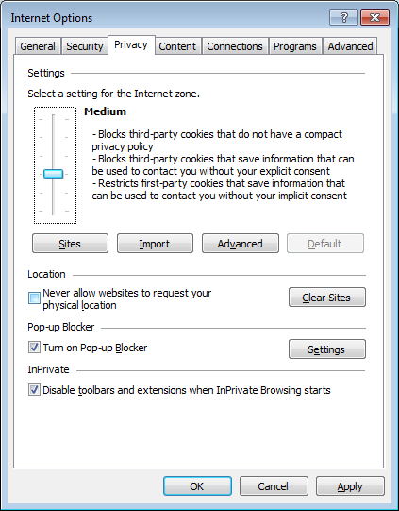
Privacy Settings
Back to our Internet Options window, click the Privacy tab.
Under the Pop-up Blocker section, click on the Settings button.

Slide 22
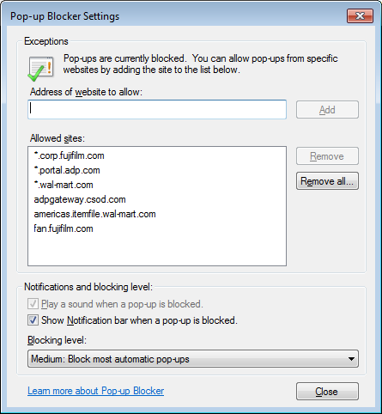
Pop-up Blocker Settings
It is important Retail Link be able to open separate tabs and/or windows. Pop-up blocker can block these causing you to think nothing has happened when you’ve selected something.
Be sure to add in the following websites to have IE not block the pop-up calls:
*.wal-mart.com
americas.itemfile.wal-mart.com
Click the Close button.
The * is a wildcard and tells the system you mean everything within the wal-mart.com master domain. If we didn’t use that wildcard, we would have to be sure to add in each website address, and there are several within the Retail Link portals.

Slide 23
Privacy Settings
Back to our Internet Options window, be sure to click the Apply button. Once that completes, click the OK button.
This applies all of the changes we have made.
Be sure to close out of IE completely and then re-launch prior to visiting any sites.

Slide 24
Happy Computing
Q & A

